Slide 1
Monster Mini-Text Game
Landon Montecalvo

Slide 2

Description of Project
Simple text game.
Randomized attack damage for player and monster.
Use of functions, loops, lists, and variables.

Slide 3
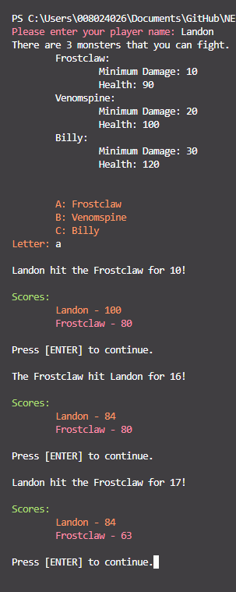
How did I decide on this project?
I decided on a text game as it would be a fun and interesting way to tie all of the concepts that we have learned so far together.

Slide 4
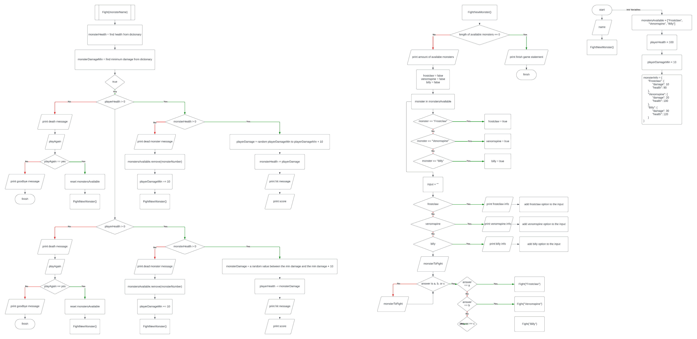
Final Project Flowchart
Flowchart Link

Slide 5
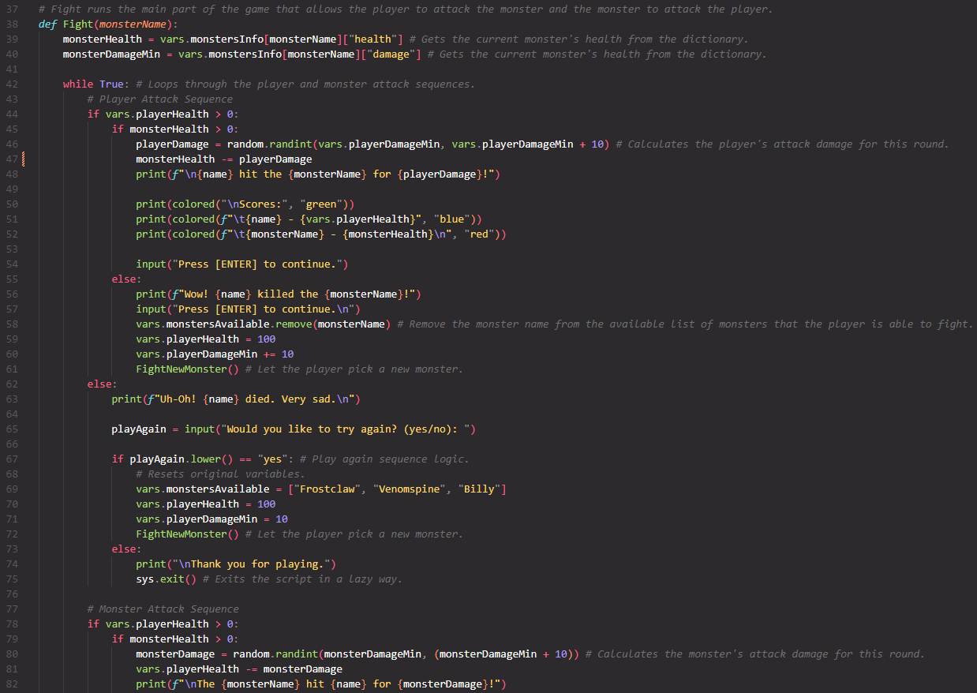
Snapshot of Code

Slide 6
What would I change?
Organization of Code
More features such as items, or skill-based attacks.
Improve story.

Slide 7
What am I most proud of?
Usage of Functions
Route that the program takes through the code.

